Slide 1
MINI PROJECT ON “DESKTOP NOTIFIER”
UNDER THE GUIDANCE : MR.P.C.DHANAWADE
STUDENT NAME: MANASI AVADHOOT MAHAJAN [19UET019]
ESHA AMIT ARORA [19UET003]
SAMIKSHA ANIL PATIL [20UET308]

Slide 2
ABOUT PROJECT :
In this project ,we will show how to create “Desktop Notifier” using python.
A desktop notifier is a simple application which produces a notification message in form of a pop up message on desktop.
This application works for any kind of operating system like windows,linux or MAC.
It is advanced technology which helps in notifying important events in our day to day life.
5) A notifier window pops out on desktop screen which helps us to remind the important work which has to be done.

Slide 3
Libraries used :
Form player import
Form Tkinter import
Form Tkinter import messagebox
Form PIL import
Image Tkinter

Slide 4
ADVANTAGES :
1) Daily notification to take madicine
2) Hourly notification to drink water
3) Set daily tracker for COVID stats

Slide 5
Disadvantages :
1) System failures
2) Single virus can destroy entire data storage
3) Hackers can hack the machine

Slide 6
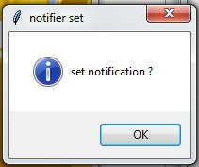

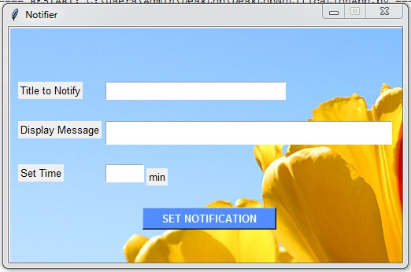
OUTPUT IMAGES

